Slide 1
Electrical Circuits and Systems
Group activity
Abhishek Srivastava : 19BCE10071
Aabir Dutta : 19BCE10062
Jahnvi Khandelwal : 19BCE10055
Vanieka Sharma : 19BCE10310
Aayushi Singh : 19BCE10151
Suman Goyal : 19BCE10386
Bhavika Chaturvedi : 19BCE10320

Slide 2
MAGNETIC CIRCUIT
&
ELECTRIC CIRCUIT

Slide 3
ELECTRIC CIRCUIT
MAGNETIC CIRCUIT
An electric circuit is a path in which electrons from a voltage or current source flow. The point where those electrons enter an electrical circuit is called the "source" of electrons. ... High-voltage direct current transmission uses big converters.
A magnetic circuit is made up of one or more closed loop paths containing a magnetic flux. The flux is usually generated by permanent magnets or electromagnets and confined to the path by magnetic cores consisting of ferromagnetic materials

Slide 4
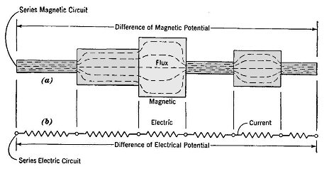
SERIES MAGNETIC CIRCUIT
The closed path followed by magnetic lines of forces is called magnetic circuit. ... The Series Magnetic Circuit is defined as the magnetic circuit having number of parts of different dimensions and materials carrying the same magnetic field.

Slide 5
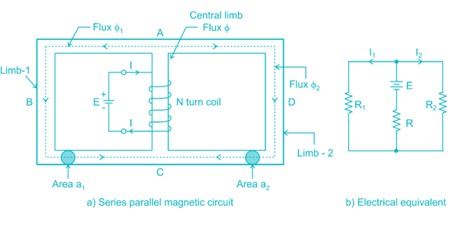
PARALLEL MAGNETIC CIRCUIT
A magnetic circuit having two or more than two paths for the magnetic flux is called a parallel magnetic circuit. Its behavior can be compared to the parallel electric circuit.The parallel magnetic circuit contains different dimensional areas and materials having various numbers of paths.

Slide 6
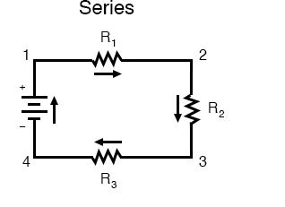
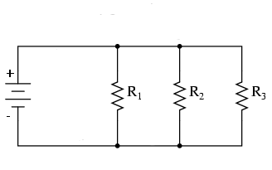
TYPES OF ELECTRIC CIRCUIT
A SERIES CIRCUIT is a circuit in which resistors are arranged in a chain, so the current has only one path to take. The current is the same through each resistor.
A PARALLEL CIRCUIT is a closed circuit in which the current divides into two or more paths before recombining to complete the circuit. Each load connected in a separate path receives the full circuit voltage.

Slide 7
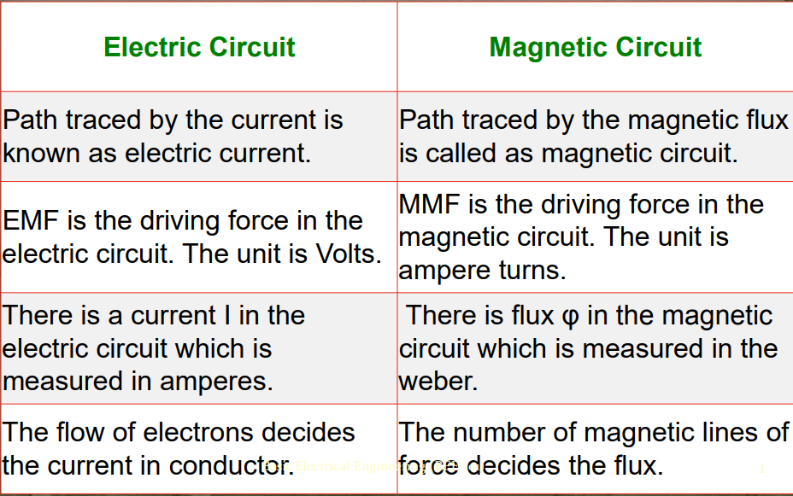
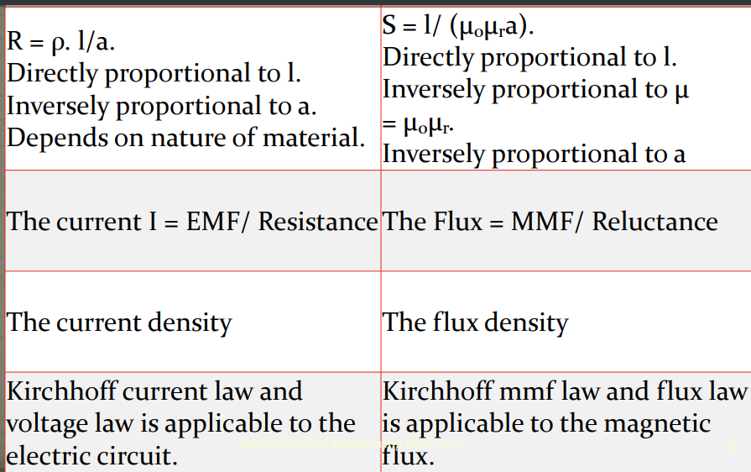
Analogy: electric circuit and magnetic circuit

Slide 8
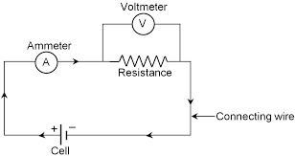
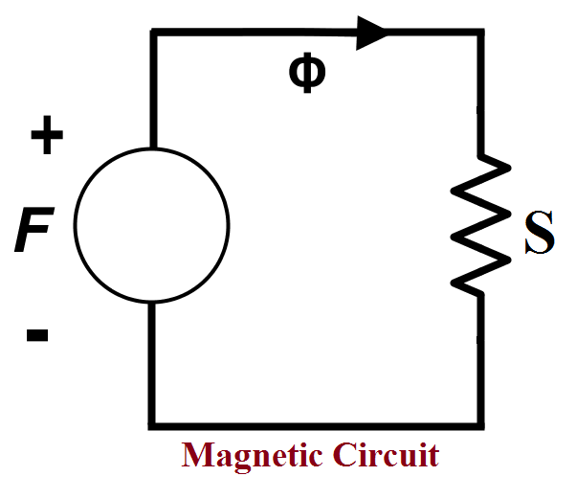
Circuit representation
Electric circuit

Slide 9
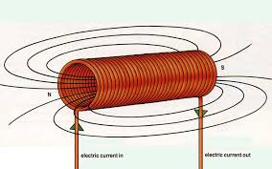
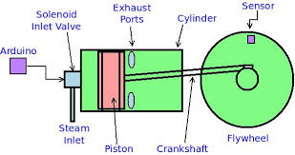
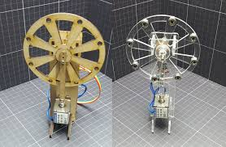
APPLICATIONS OF SELF INDUCTION
1.Solenoid:-
A solenoid with a changing current running through it will generate a changing magnetic field. This changing magnetic field is then captured by the very solenoid that created it. A captured field is called flux and a changing flux generates an emf-in this case, a self induced or back emf.
An engine that works with the help of solenoid engine. It converts the magnetic energy produced by solenoid into mechanical energy. The speed of the flywheel depends on the intensity of magnetic field generated by solenoid. Hence, high voltage will result in more rpm of flywheel.

Slide 10
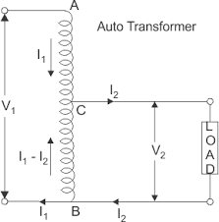
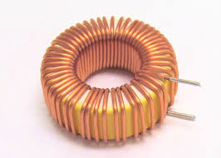
2.Auto transformers
The auto-transformer works on the principle of self-induction i.e. induce the. An autotransformer has a single winding with two end terminals, and one or more terminals at intermediate tap points. It is a transformer in which the primary and secondary coils have part of their turns in common electromagnetic force in the circuit due to variation in current.
3.TOROIDAL INDUCTORS
A toroid is a coil of insulated or enameled wire wound on a donut-shaped form made of powdered iron. A toroid is used as an inductor in electronic circuits, especially at low frequencies where comparatively large inductances are necessary. In a toroid, all the magnetic flux is contained in the core material.

Slide 11
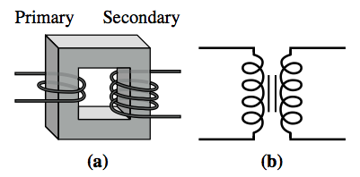
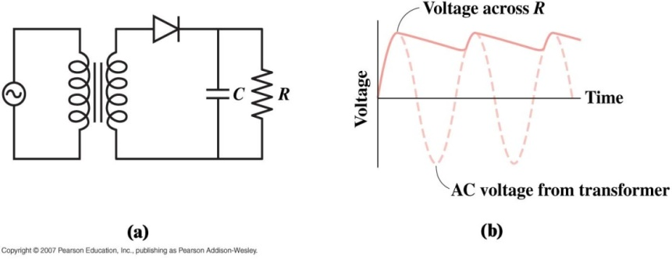
Application Of Mutual Induction
1. Transformers and power supplies
A transformer is a pair of coils linked by mutual inductance.
An AC current in the primary induces a current in the secondary.
The secondary voltage differs from the primary voltage by the ratio of the number of turns.
Both step-up and step-down transformers are possible.
Transformers are used to produce low voltages for electronic equipment.
Then they’re combined with diodes that convert AC to DC and capacitors to smooth the DC voltage.

Slide 12
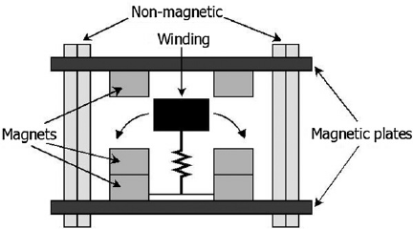
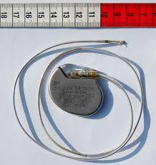
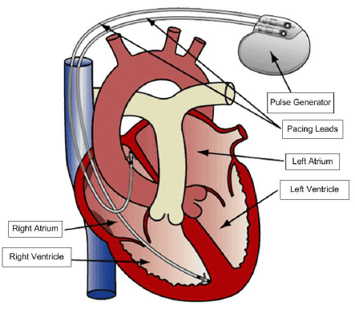
Application Of Mutual Induction
2. Pacemakers
It’s not easy to change the battery
Instead, use an external AC supply.
Alternating current
alternating B
alternating ФB inside “wearer”
induces AC current to power pacemaker

Slide 13
THANK YOU

